Slide 1
Amazon Movie Recommender System
Lindsay Jap, Jason Koh, Weiming Khoo, Ben Tan

Slide 2
Background
Start up providing movies for Amazon.
Objective: Keeping customers engaged with platform by recommender system. At the same time, increase revenue and users.
Why ML: Complex with many data points.
KPI metrics: Click through rate for recommendation, overall engagement rate.

Slide 3
Approach
Preprocessing:
Data shape
Relevant columns: Customer ID, Product ID, Star Rating.
Quantile: analysis of balanced / imbalanced data.
Data Cleaning
Data Preparation for Modelling
Data Modelling & Evaluation - 3 steps
Factorization Machines using Regressions
Factorization Machines using Binary Classification
Binary Classification as Feature with KNN classification

Slide 4
Procedure
Data loading and ingestion to Notebook from S3 bucket
After data prep, convert to RecordIO Protobuf format for faster training.
Initialize modelling with SageMaker Built in Algorithm.
Deploy model
Evaluate result
Write JSON serializer for predictions and interaction with API endpoint:
Amazon SageMaker model containers must respond to requests within 60 seconds. The model itself can have a maximum processing time of 60 seconds before responding to the /invocations. To do that, only do predictions for 5 at a time, so no timeout.
Batch transform to get 100 recommendations for each user

Slide 5
Pre-processing - Data cleaning
Almost 4m rows of dataset, with very few missing data.
Important information such as customer_id, product_id, and star_rating do not have missing data. Some duplication due to repeated reviews and stars given, but easily manageable.
Extracted customer_id, product_id and index them from 1 to len(data).
Star_rating is the main feature that our model will based on.
Quantile analysis suggested 95% of customers have less than 5 reviews and 90% of products have less than 10 reviews.
Decided to filter to customer who has at least left 18 reviews and products with at least 95 reviews.
Final number of records: 173,500 rows

Slide 6
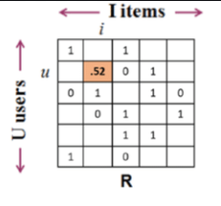
Pre-processing - for ML
Test data is generated by getting the last review from each customer. Number of records: 10,436
Training data is generated by whole dataset minus the test data. Number of records: 163,064
Data conversion from rows and columns to sparse_matrix.

Slide 7
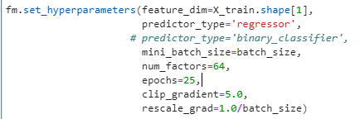
Model Training - 1st Iteration
Data is fed into factorization machines algo with regressions model to predict the rating of that users going to leave a certain product (movie).
The `batch_size` is set to 128. This value can be tuned for relatively minor improvements in fit and speed, but selecting a reasonable value relative to the dataset is appropriate in most cases. `num_factors` is set to 64. Factorization machines find a lower dimensional representation of the interactions for all features. Making this value smaller provides a more parsimonious (simple) model, closer to a linear model, but may sacrifice information about interactions. Making it larger provides a higher dimensional representation of feature interactions but adds computational complexity and can lead to overfitting. In a practical application, time should be invested to tune this parameter to the appropriate value.

Slide 8
Model Training - 1st Iteration
2. Model performance:
The MSE, RMSE, and Absolute loss are approx 20% lower in the training set than in the testing dataset. This might indicate that the model is being molded to the pattern of the training set and not the general pattern on the reviews. This is considered overfitting.

Slide 9
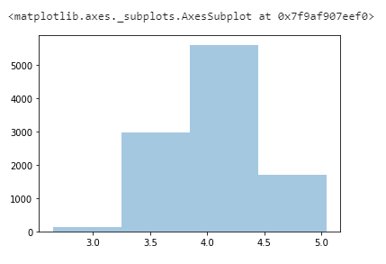
Model Training - 1st Iteration
3. Baseline MSE from Naive guess (based on training_df.star_rating.mean()): 1.502
4. Test_df predictions result, MSE: 1.242 (better than baseline!)
Review prediction clustered around 3.25 to 4.4

Slide 10
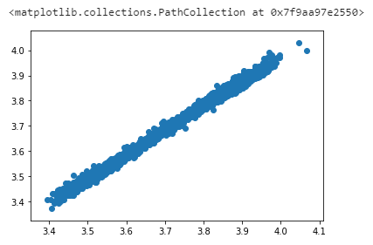
Model Training - 1st Iteration
b. Checking 2 users prediction results yield high correlations. Essentially, the average rating of items dominates across users, and our system will recommend the same well-reviewed items to everyone. That basically means that the model is only finding the best rated shows and presenting them to all users.

Slide 11
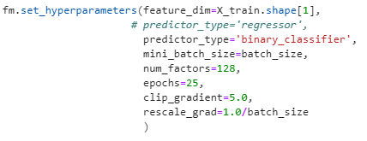
Model Training - 2nd Iteration
Same data prep from regression is fed to factorization machines algo with binary classification model. Output will be yes/no depending on whether the customer will leave 5* review.
batch_size=512

Slide 12
Model Training - 2nd Iteration
2. Model performance:
Accuracy is higher in the training set than in validation set. However, it is not significantly higher (within +/- 5%). Hence, we could say that this model generalizes well.

Slide 13
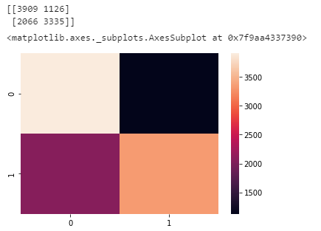
Model Training - 2nd Iteration
3. Test set performance:
Accuracy: 0.694
3909
1126
vs
Naive categorization: 0.497
2066
3335
The model is being conservative and preferring not to recommend things to users. That means most of the mistakes the model is making come from not recommending movies to users.

Slide 14
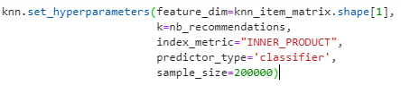
Model Training - 3rd Iteration
Using the output from 2nd iteration as feature to train KNN model.
Question: why there is no test data mentioned? What should be the metrics for evaluation?

Slide 15
Model Training - 3rd Iteration
2. Do batch inference to get 100 recommendations for 2 users, and then compare the result. Here is the overlap for the both.

Slide 16
Next Steps
Bring in richer CRM data of age, gender, marital status, purchase_date.
Bring in more information on the product itself, like genre, date_released, etc.
Bring in website activity data of session duration, pageviews / session, session in a week, pages viewed, etc.
Bring in more transactional data from other purchases in Amazon.

